Slide 1

Building a process-based model, from scratch
Camille Minaudo
Sistemes Dinàmics en Ecologia

Slide 2
Outline
PART 1
What is a process-based model?
Why do we want process-based models?
Building a model from scratch
Modelling lake metabolism rates
PART 2
Step-by-step model implementation using R, GitHub and Binder

Slide 3
What is a process-based model?
A representation of the way the world works
Reproduces a level of realism
However, models are necessary simplifications and do not explain all the variance in observational data
A process-based model is a model that takes an object-oriented perspective, identifying:
the relevant entities (included properties)
their state
and their behaviours.

Slide 4
Why process-based models?
Can be used for scenarios that are out of sample
To challenge our level of understanding of the way our world works
From system A to system B
Accommodates a variety of data, even if sampled irregularly
Used to infill missing data

Slide 5
Building a model from scratch
What do I want to model?
State variables
What do I know about my state variables?
State
Behaviour = processes (= equations)
Boundary conditions
What data (observations) do I need?
How do I want to build my model?
Numerical scheme
Programming language
Numerical platform
Let’s go!

Slide 6
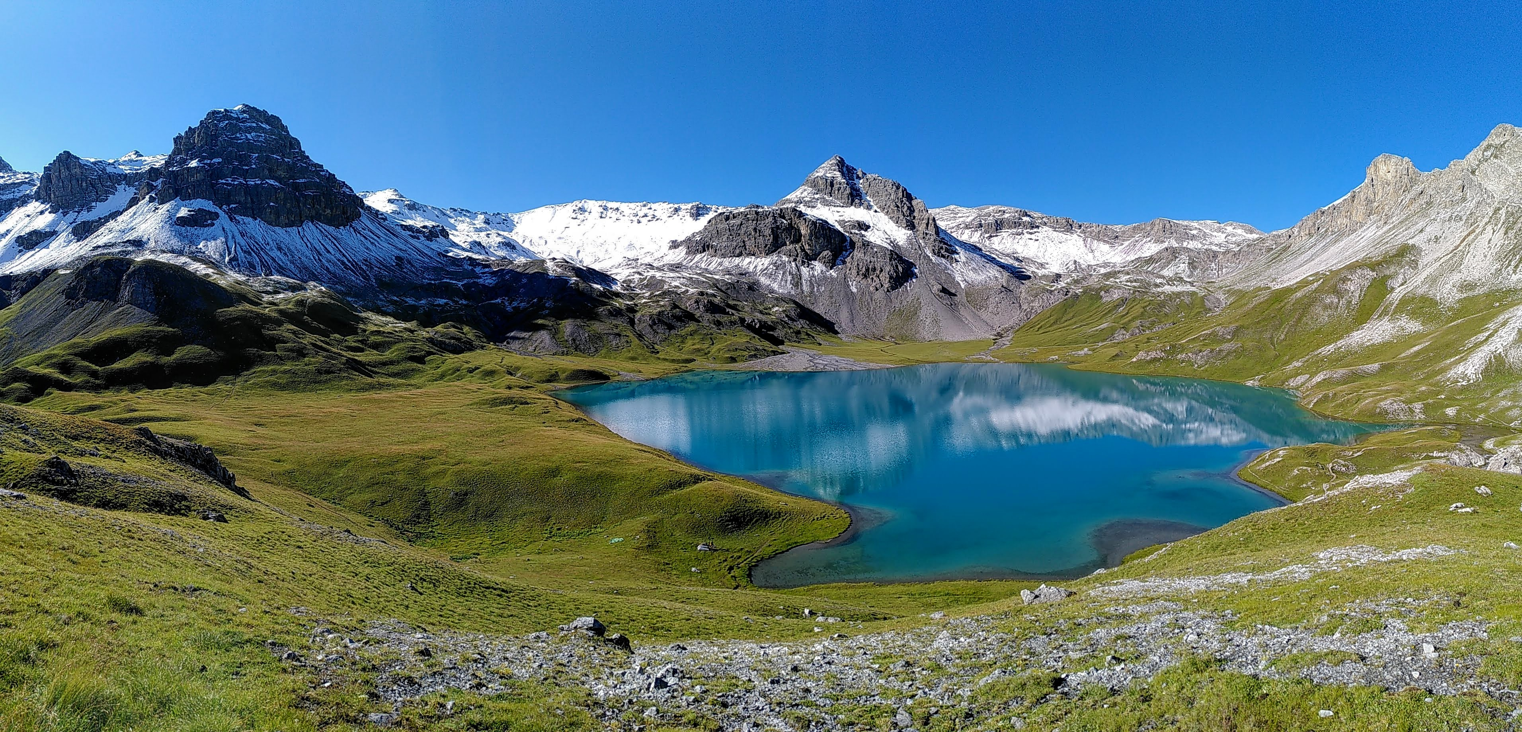
Application
Modelling lake metabolism rates

Slide 7
Air
Lake
Dissolved oxygen
Sediment

Slide 8

Air
Atmospheric exchange
Lake
in
Dissolved oxygen
out
Sediment
$\frac{dDO(t)}{dt}=f({Physical}_{fluxes}\left(t\right)$)

Slide 9

Air
Atmospheric exchange
Lake
Organic Matter
in
Dissolved oxygen
out
Sediment
$$\frac{dDO(t)}{dt}=f({Organic Matter, Physical}_{fluxes}\left(t\right)\text{)}$$

Slide 10
Air
Atmospheric exchange
Lake
Production
Organic Matter
in
Dissolved oxygen
out
Respiration
Sediment
$$\frac{dDO(t)}{dt}=Production\left(t\right)−Respiration\left(t\right)+{Physical}_{fluxes}\left(t\right)$$

Slide 11


$$F_{atm}\left(t\right) =f(DO\left(t\right),temperature\left(t\right),k_{DO}(t))$$
Air
$$F_{atm}$$
Temp.
Lake
NPP
Organic Matter
in
Dissolved oxygen
R
out
Sediment
$\frac{dDO(t)}{dt}=NPP\left(t\right)−R\left(t\right)+F_{atm}\left(t\right)+φ$ $\left(t\right)$

Slide 12


$$F_{atm}\left(t\right) =f(DO\left(t\right),temperature\left(t\right),k_{DO}(t))$$
Air
$$F_{atm}$$
Temp.
Lake
Phyto
in
Dissolved oxygen
R_{phyto}
out
Settling
R_{DOC}
DOC
Sediment
$\frac{dDO(t)}{dt}=NPP\left(t\right)−R\left(t\right)+F_{atm}\left(t\right)+φ$ $\left(t\right)$
$R\left(t\right) =R_{phyto}\left(t\right)$+ $R_{DOC}\left(t\right)$
$$\frac{dPhyto(t)}{dt}=NPP\left(t\right)−R_{phyto}\left(t\right)−Settling(t)$$

Slide 13
Solar radiations
Air
$$F_{atm}$$
Temp.
Nutrients
Lake
NPP
Phyto
in
Dissolved oxygen
R_{phyto}
out
Settling
R_{DOC}
DOC
Sediment
$\frac{dDO(t)}{dt}=NPP\left(t\right)−(R_{phyto}\left(t\right)\text{+ }R_{DOC}\left(t\right))+F_{atm}\left(t\right)+φ$ $\left(t\right)$
$$NPP\left(t\right) =f(Radiations\left(t\right), \left[Nutrients\right]\left(t\right), temperature(t))$$

Slide 14


Solar radiations
Air
$$F_{atm}$$
Temp.
Nutrients
Lake
NPP
Phyto
in
Dissolved oxygen
R_{phyto}
out
Settling
R_{DOC}
DOC
Sediment
$\frac{dDO(t)}{dt}=NPP\left(t\right)−(R_{phyto}\left(t\right)\text{+ }R_{DOC}\left(t\right))+F_{atm}\left(t\right)+φ$ $\left(t\right)$
$$NPP\left(t\right) =f(Radiations\left(t\right), \left[Nutrients\right]\left(t\right), temperature(t))$$
$$R_{DOC}\left(t\right)=f([DOC](t))$$
$$Settling\left(t\right)=f(z_{mix} \left(t\right),Phyto(t))$$

Slide 15

Solar radiations
Air
$$F_{atm}$$
Temp.
Nutrients
NPP
Phyto
in
Dissolved oxygen
R_{phyto}
Hydrolysis
out
R_{DOC}
DOC
Settling
epilimnion
$$Entrainment$$
Sediment
hypolimnion
R_{Sed}
Mineralization
Sediment
Nutrients
Burial

Slide 16
Solar radiations
Air
$$F_{atm}$$
Temp.
Nutrients
Lake
NPP
Phyto
in
Dissolved oxygen
R_{phyto}
out
Settling
R_{DOC}
DOC
Sediment
$\frac{dDO(t)}{dt}=NPP\left(t\right)−(R_{phyto}\left(t\right)\text{+ }R_{DOC}\left(t\right))+F_{atm}\left(t\right)+φ$ $\left(t\right)$

Slide 17
Solar radiations
Air
$$F_{atm}$$
Temp.
Nutrients
Lake
NPP
Phyto
Dissolved oxygen
R_{phyto}
z_{mix}
Settling
R_{DOC}
DOC
Sediment
Sediment

Slide 18
In discrete time form
$$\frac{dDO(t)}{dt}=NPP\left(t\right)−(R_{phyto}\left(t\right)\text{+ }R_{DOC}\left(t\right))+F_{atm}\left(t\right)$$
$$DO\left(t\right)=DO\left(t−1\right)+ NPP\left(t\right)∙k_{C→O2}−(R_{phyto}\left(t\right)\text{+ }R_{DOC}\left(t\right))∙k_{C→O2}+F_{atm}\left(t\right)$$
Oxygen at the current time step (t), is equal to what it was at the previous time step (t-1), plus the mass movement of oxygen through a set of processes : gross primary production, respiration, atmospheric exchange and physics.
In a R code:
doPredic[i] = doPredic[i-1] + npp[i]*CtoO2 - Rtot[i]*CtoO2 + fatm[i]

Slide 19

In discrete time form
$$\frac{dPhyto(t)}{dt}=NPP\left(t\right)−R_{phyto}\left(t\right)−Settling(t)$$
$$phyto\left(t\right)= phyto\left(t−1\right)+ NPP\left(t\right)−R_{phyto}\left(t\right)−Settling(i)$$
Phytoplankton biomass at the current time step (t), is equal to what it was at the previous time step (t-1), plus what is being produced through photosynthesis, minus what is lost by respiration and settling
In a R code:
phyto[i] = phyto[i-1] + npp[i] - Rphyto[i] – Settling[i]

Slide 20

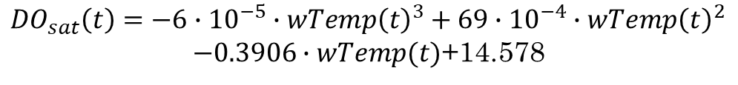


Additional equations
$$F_{atm}\left(t\right) =dt∙k_{DO}\left({DO}_{sat}\left(t\right)−DO\left(t−1\right)\right)/z_{mix}$$
$${DO}_{sat}\left(t\right)=−6∙{10}^{−5}∙{wTemp\left(t\right)}^{3}+69∙{10}^{−4}∙{wTemp\left(t\right)}^{2}$$
$−0.3906∙wTemp(t)$+14.578
$Settling\left(t\right)=$ $dt∙phyto\left(t−1\right)\frac{{settling}_{phyto}}{z_{mix}}$
$$NPP\left(t\right)=dt∙PAR(t)∙phosphorus∙pNPP∙{θ_{NPP}}^{(wTemp\left(t\right)−20)}$$
$$R_{DOC}\left(t\right)=dt∙DOC∙docR$$
$$R_{phyto}\left(t\right)=dt∙phyto(t−1)∙phytoR∙{θ_{R}}^{(wTemp\left(t\right)−20)}$$
$${R\left(t\right)=R}_{DOC}\left(t\right)+R_{phyto}\left(t\right)$$

Slide 21
These equations (in a R code)
fatm[i] = dt ∗ kDO ∗ (dosat[i] − doPredic[i−1]) / zMix
dosat[i] = -0.00006 * wTemp[i]^3 + 0.0069 * wTemp[i]^2
- 0.3906 * wTemp[i] + 14.578
Settling[i] = dt ∗ phyto[i−1] ∗ settlingPhyto/zMix
npp[i] = dt * PAR[i] * phosphorus * pNPP *
thetaNPP^(wTemp[i] - 20)
RDOC[i] = dt * DOC * docR
Rphyto[i] = dt * phyto[i-1] * phytoR * thetaR^(wTemp[i] - 20)
Rtot[i] = RDOC[i] + Rphyto[i]

Slide 22
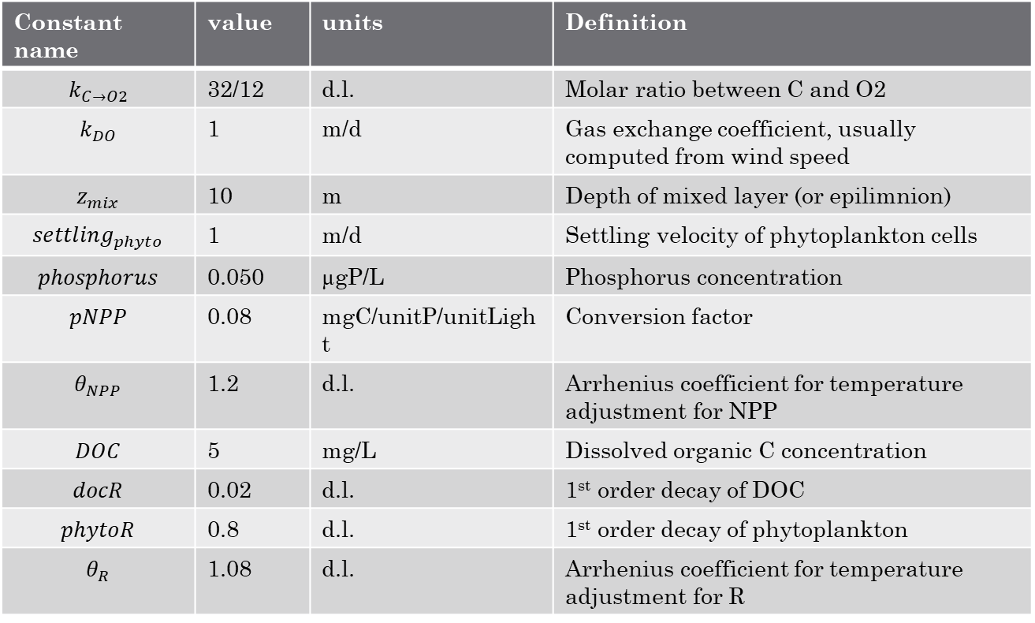
Constants
Constant name | value | units | Definition
$$k_{C→O2}$$ | 32/12 | d.l. | Molar ratio between C and O2
$$k_{DO}$$ | 1 | m/d | Gas exchange coefficient, usually computed from wind speed
$$z_{mix}$$ | 10 | m | Depth of mixed layer (or epilimnion)
$${settling}_{phyto}$$ | 1 | m/d | Settling velocity of phytoplankton cells
$$phosphorus$$ | 0.050 | µgP/L | Phosphorus concentration
$$pNPP$$ | 0.08 | mgC/unitP/unitLight | Conversion factor
$$θ_{NPP}$$ | 1.2 | d.l. | Arrhenius coefficient for temperature adjustment for NPP
$$DOC$$ | 5 | mg/L | Dissolved organic C concentration
$$docR$$ | 0.02 | d.l. | 1st order decay of DOC
$$phytoR$$ | 0.8 | d.l. | 1st order decay of phytoplankton
$$θ_{R}$$ | 1.08 | d.l. | Arrhenius coefficient for temperature adjustment for R

Slide 23
Demo
https://github.com/camilleminaudo/oxygen-model-demo

Slide 24
Part 2
Model implementation

Slide 25




You have RStudio installed
https://github.com/camilleminaudo/oxygen-model-students
Option A: download the entire repository
Option B: clone to this repository
oxygenModel.Rmd

Slide 26

You don’t have RStudio installed
https://github.com/camilleminaudo/oxygen-model-students
oxygenModel.Rmd

Slide 27
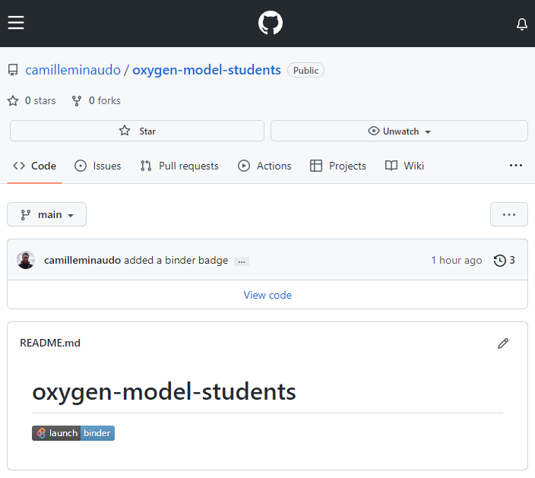
The model, step by step
Create a GitHub account
Go to https://github.com/camilleminaudo/oxygen-model-students
Click on “lauch binder” in the README.md file
Wait for installation and Jupyter install
Open a Rstudio notebook
Open the file oxygenModel.Rmd
Follow instructions and run the model

